Slide 1


For loop, Break and Continue

Slide 2
List of content
For loop
Nested For loop
Break
Continue

Slide 3
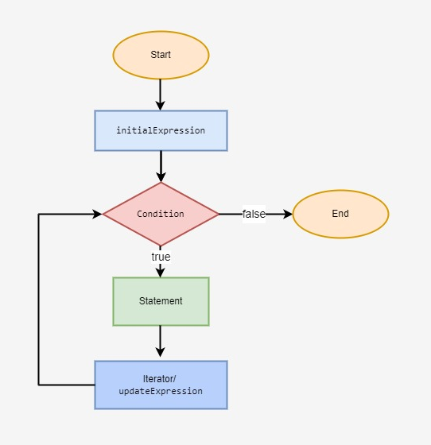
For Loop
Syntax :
for (initial expression; condition; update expression) {
// for loop body
}

Slide 4
For loop
Initial Expression only ever executes once while initializing and declaring variables.
The condition is assessed.
The for loop is ended if condition is false.
The for loop's code block is performed if the condition is satisfied.
When the condition is true, the update expression changes the initial expression's value.
The condition is once more assessed. Up till the condition is false, this process keeps going.

Slide 5
Example :
Using For loop print “PW Skills” 3 times

Slide 6
Example :
Display a sequence of even numbers till 20

Slide 7
Nested for loop
An outer for loop and one or more inside for loops constitute a nested for loop.
Control re-enters the inner for loop and initiates a fresh execution every time the outer for loop repeats.
In other words, every time the outer for loop repeats, the control will enter the inner for loop.
// Outer for loop
for ( initialization; test-condition; increment/decrement )
{
// Inner for loop
for ( initialization; test-condition; increment/decrement )
{
// statement of inner loop
}

Slide 8
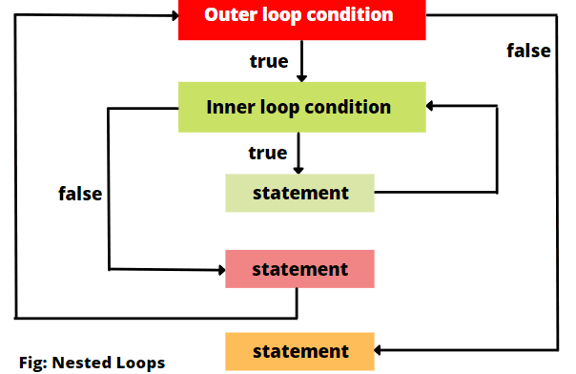
Flowchart of nested for loop

Slide 9
Example :
Write a program to show the inner for loop values for each outer iteration in along with the outer for loop.

Slide 10
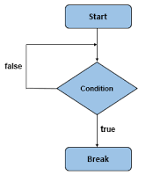
What is break ?
A loop such as a for, do...while, or while loop, a switch, or a label statement are all prematurely terminated by the break statement. The break statement syntax is as follows:
break [label];

Slide 11
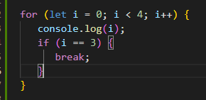
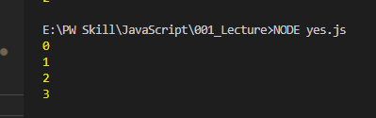
Example of using break with for loop

Slide 12
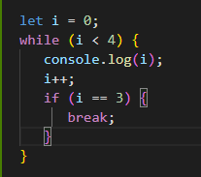

Example of using break with while loop

Slide 13
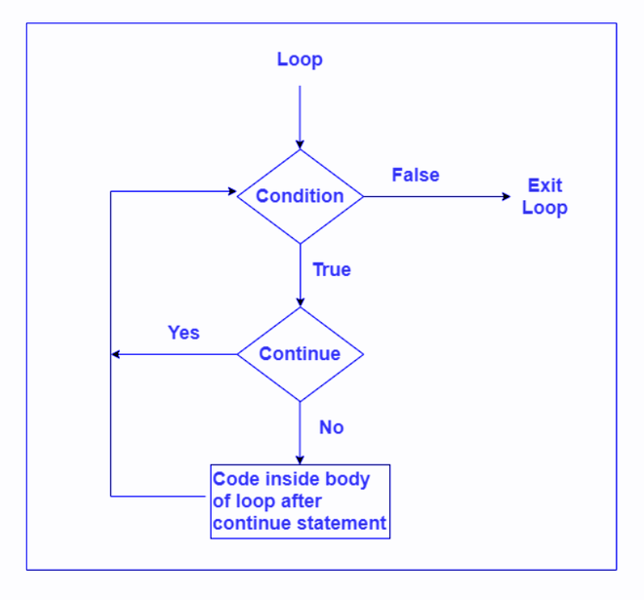
What is continue?
The current iteration of the loop is skipped when using the continue statement, and the program moves on to the subsequent iteration.
The syntax of the continue statement is:
continue [label];
label is optional and rarely used.

Slide 14
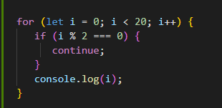
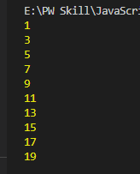
Example of using continue in for loop
Write a program to display only odd numbers till 20

Slide 15
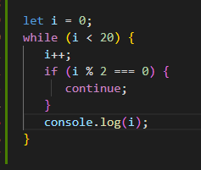
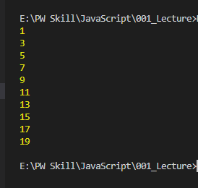
Example of using continue in while loop
Write a program to display only odd numbers till 20

Slide 16
THANK YOU

